Slide 1


City of Hermiston
UGB Expansion, Comprehensive Plan Amendment, Annexation, and Zone Change
Umatilla County Board of Commissioners Hearing
October 15, 2025
Notes:
Applicable Criteria:
Statewide Planning Goals 1, 2, 9, and 11–13.
OAR 660, Division 24, Sections 0040—0067.
OAR 660, Division 11.
Comprehensive Plan Policies 1, 2, 3, 4, 5, and 6.
City Code Sections 150.05, 156.08, and 157.226.
ORS 222.111–175.

Slide 2
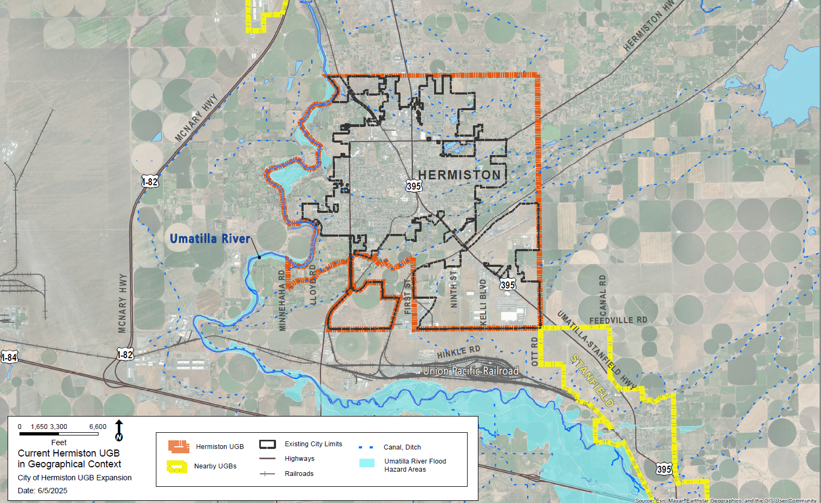
2

Slide 3
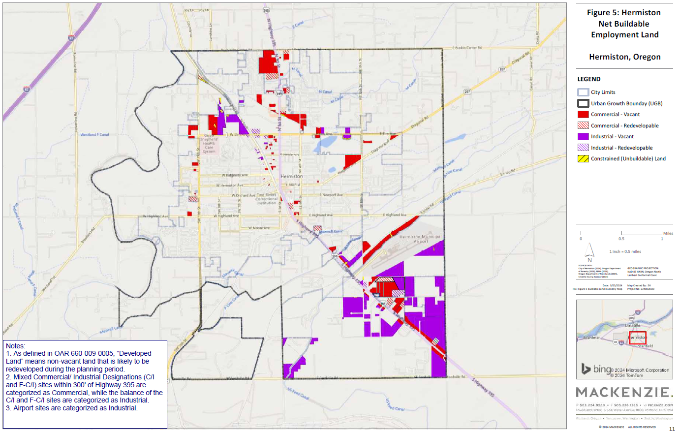
2024 Economic Opportunities Analysis (EOA)
Needed: 1,210 gross buildable acres for data center development identified in the EOA
Two suitable HDC sites under development (214 acres)
No other suitable land for HDC development within the UGB
Deficiency: Nine HDC sites, each at least 100 suitable acres needed to be added to the UGB

Slide 4
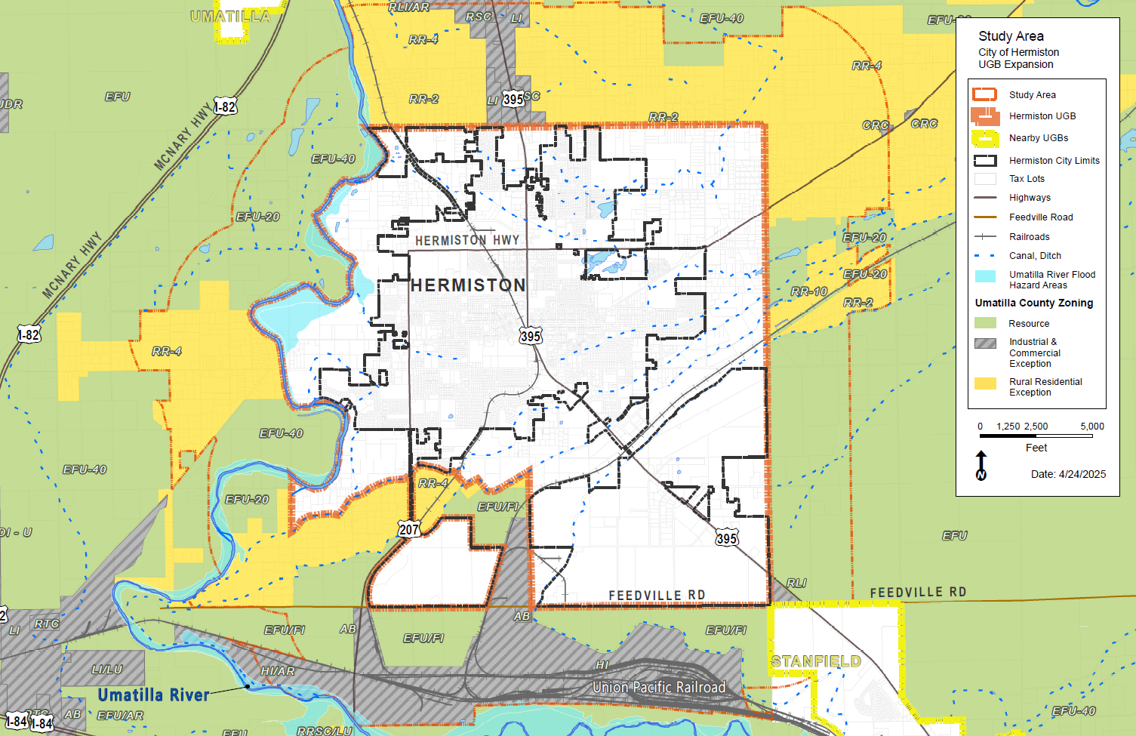
4
Notes:
Study Area:
A 1.0 and 1.5-mile buffer
Not included: Cities of Umatilla and Stanfield UGBs

Slide 5
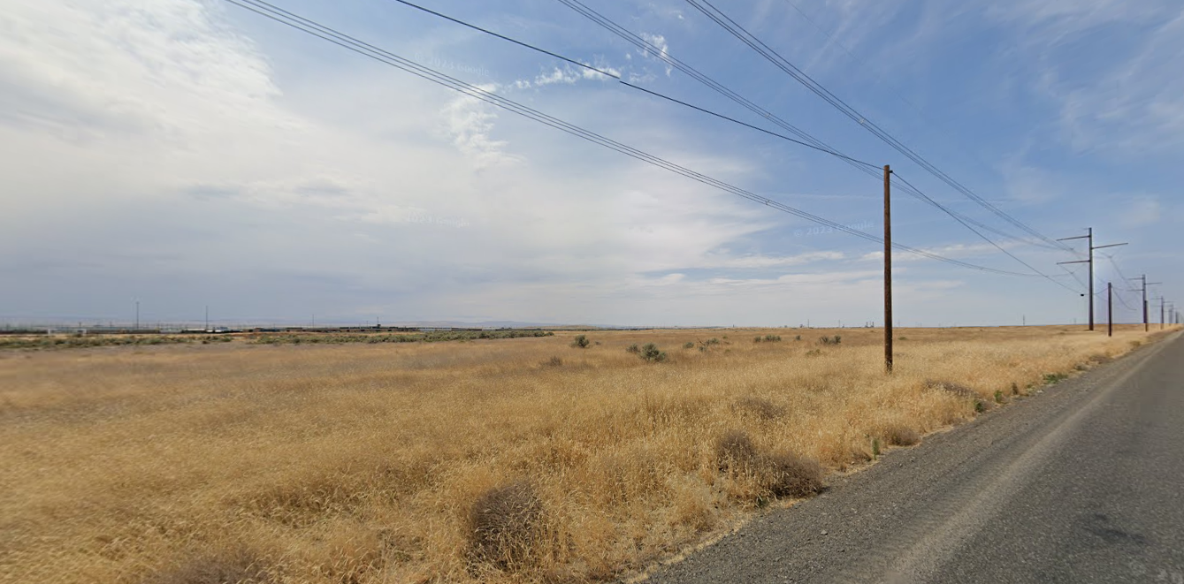
Required Hyperscale Data Center (HDC) Site Characteristics
Size:
Tracts ≥ 100 contiguous acres after removal of constrained land
Individual tax lots > 20 acres
Uninterrupted by road, railway, or water body
Topography and Location:
5% maximum grade
Outside of special flood hazards
200-foot buffer from residential uses
Serviceability:
Access to urban services from Hermiston UGB
5
Notes:
Size:
Tracts ≥ 100 contiguous acres after removal of constrained land
Individual tax lots > 20 acres
Uninterrupted by road, railway, or water body
Topography and location:
5% maximum grade
Outside of special flood hazards
NEW since last meeting – 200-foot residential buffer
Serviceability:
Access to urban services from Hermiston UGB

Slide 6
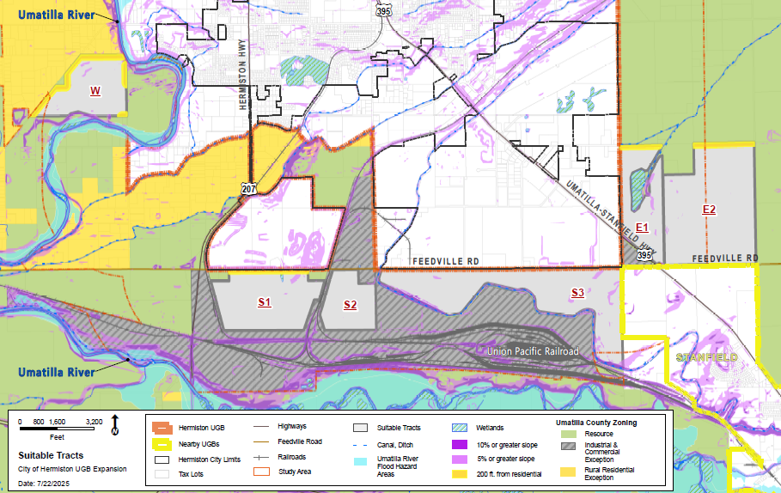
Required Hyperscale Data Center (HDC) Site Characteristics
Tract ID | Suitable Acres*
W | 148
S1 | 226
S2 | 120
S3 | 379
E1 | 152
E2 | 422
*Total acreage of constraints subtracted from total acres of site.
6
Notes:
Size:
Tracts ≥ 100 contiguous acres after removal of constrained land
Individual tax lots > 20 acres
Uninterrupted by road, railway, or water body
Topography and location:
5% maximum grade
Outside of special flood hazards
NEW since last meeting – 200-foot residential buffer
Serviceability:
Access to urban services from Hermiston UGB

Slide 7
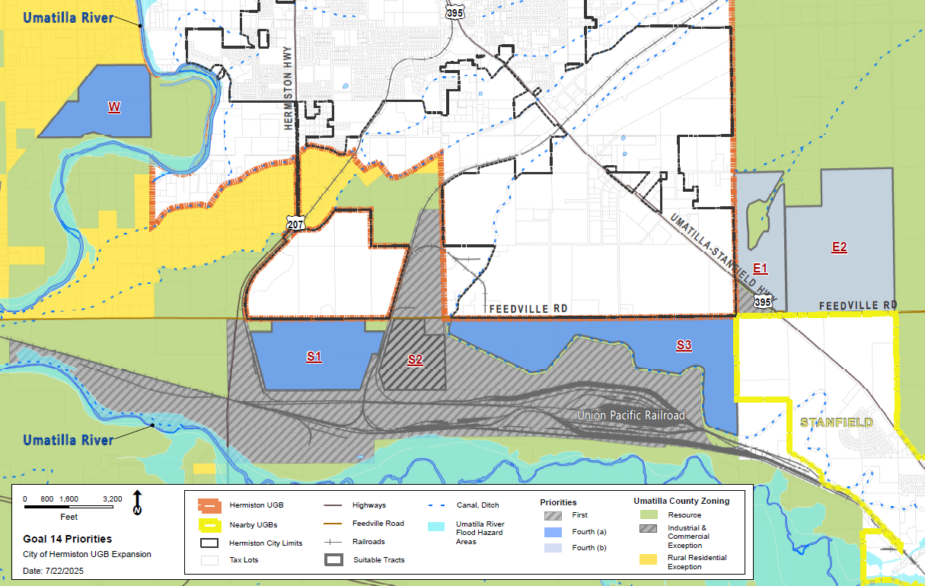
Suitable Goal 14 Priority Tracts
First Priority: Urban Reserve, exception land, and nonresource land.
Second Priority: Marginal land.
Third Priority: Forest or farm land that is not predominantly high-value farm land.
Fourth Priority: Agricultural land that is predominantly high-value farmland.

Slide 8
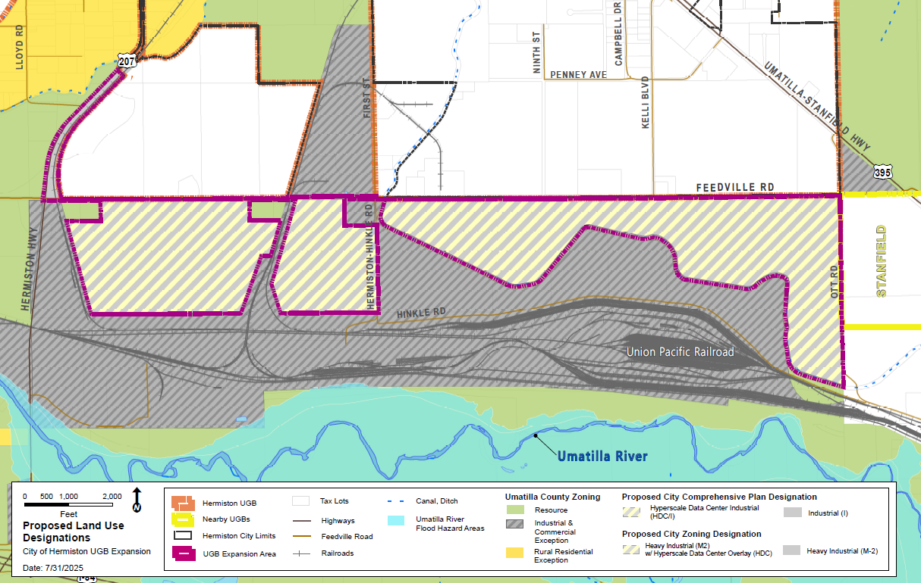
Proposed Expansion and Annexation Area
S3
S1
S2
Result: Five suitable HDC sites in three suitable tracts within UGB and city limits.
and Annexation Area
Notes:
Talk about proposed text amendment for zoning/overlay.

Slide 9
Umatilla County Coordination – Co-Adoption and Conversion
The JMA requires:
  Co-adoption of amendments to the HCP.
  Co-adoption of city land use regulations and zoning designations.
Annexation:
  Proposed Urban Industrial with HDC overlay.
    None of the proposed land is currently “urbanizable,” will go straight to urban.
  PFP Analysis and HDC Conceptual Plan demonstrate orderly growth and serviceability.
S3
S1
S2
and Annexation Area
Notes:
Entire area UGB expansion area is proposed to be annexed.
Proposal is going straight to urban land (not through urbanizable).
Demonstration of Orderly Urban Growth
PFP analysis for the expansion area is part of the package.
HDC Conceptual Development Plan.
Application of urban HDC overlay to control possible development on site.

Slide 10
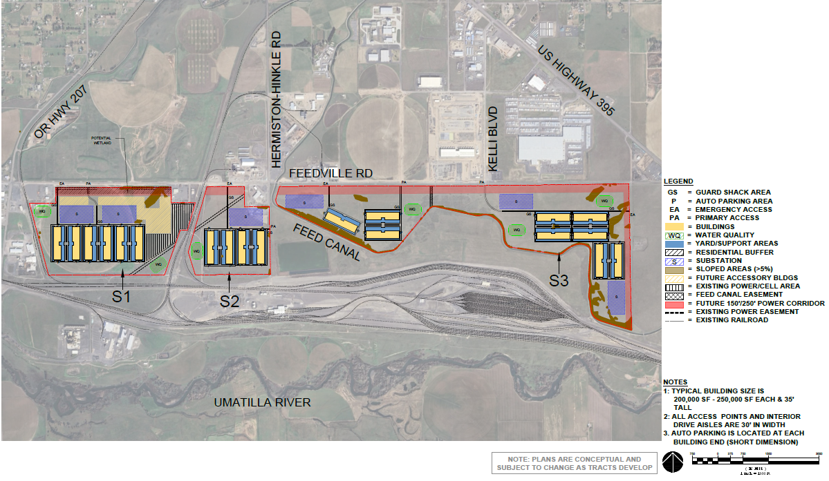
Hyperscale Data Centers Concept Plan
Expansion area evaluation
ID | Final Suitable Acres*
S1 | 220
S2 | 111
S3 | 312
TOTAL | 643
*Required and existing easements removed.
Notes:
Easements were also removed, which affected the available acres and total building count.

Slide 11
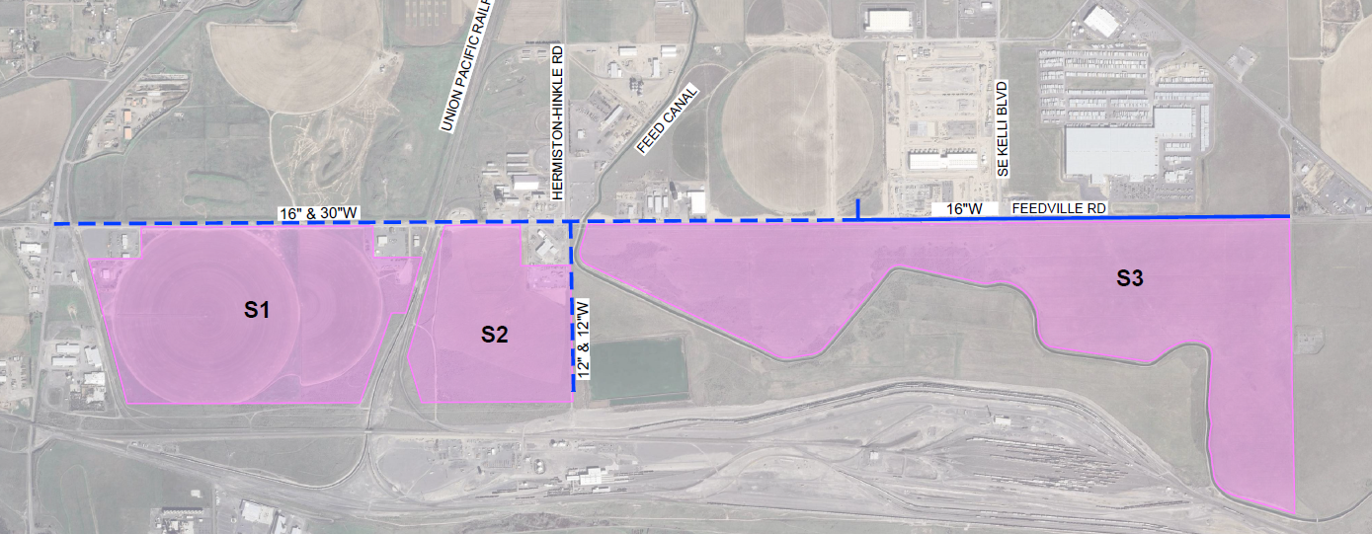
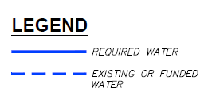

Public Facilities – Water
ASR Well – Potable Water for S1 and S3
ASR WATER WELL
Proposed Water Mainline Extension
Existing or Funded Water Line
OTT RD

Slide 12
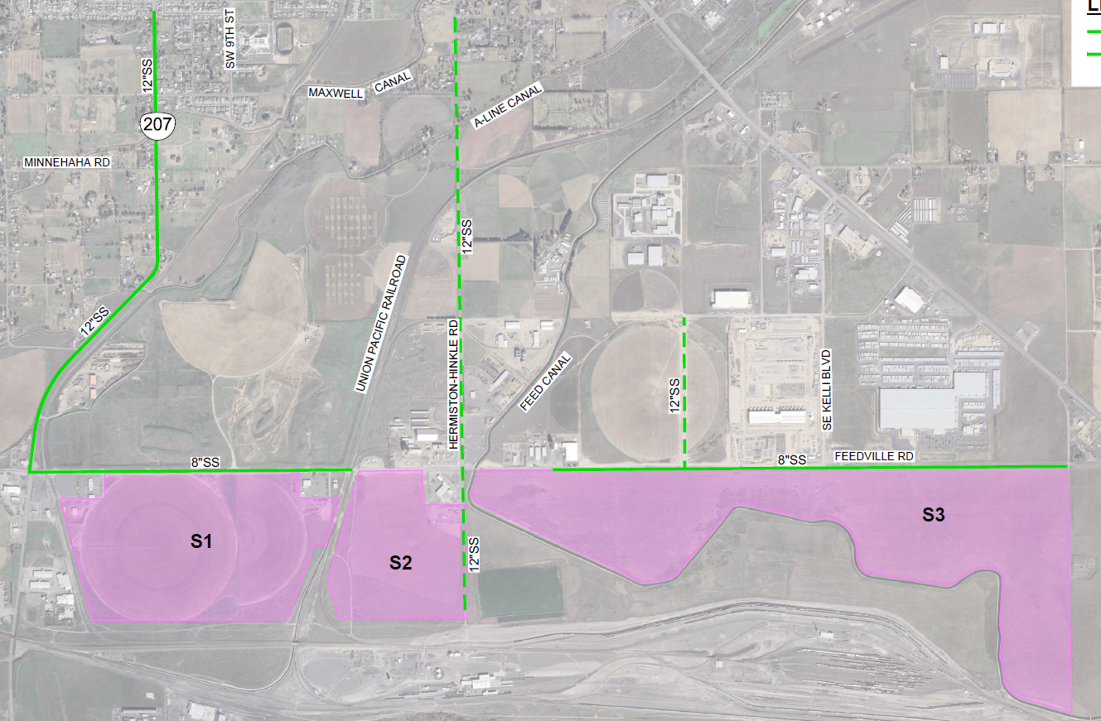

Public Facilities – Sewer
W Joseph Ave
Existing or Funded Sewer Line
E 9th St
* Sewer main lines downstream of the S3 connection require upsizing to handle additional flow near Lift Station No. 1.
Proposed Sewer Gravity Mainline Extension
Proposed Sewer Gravity Mainline Extension

Slide 13
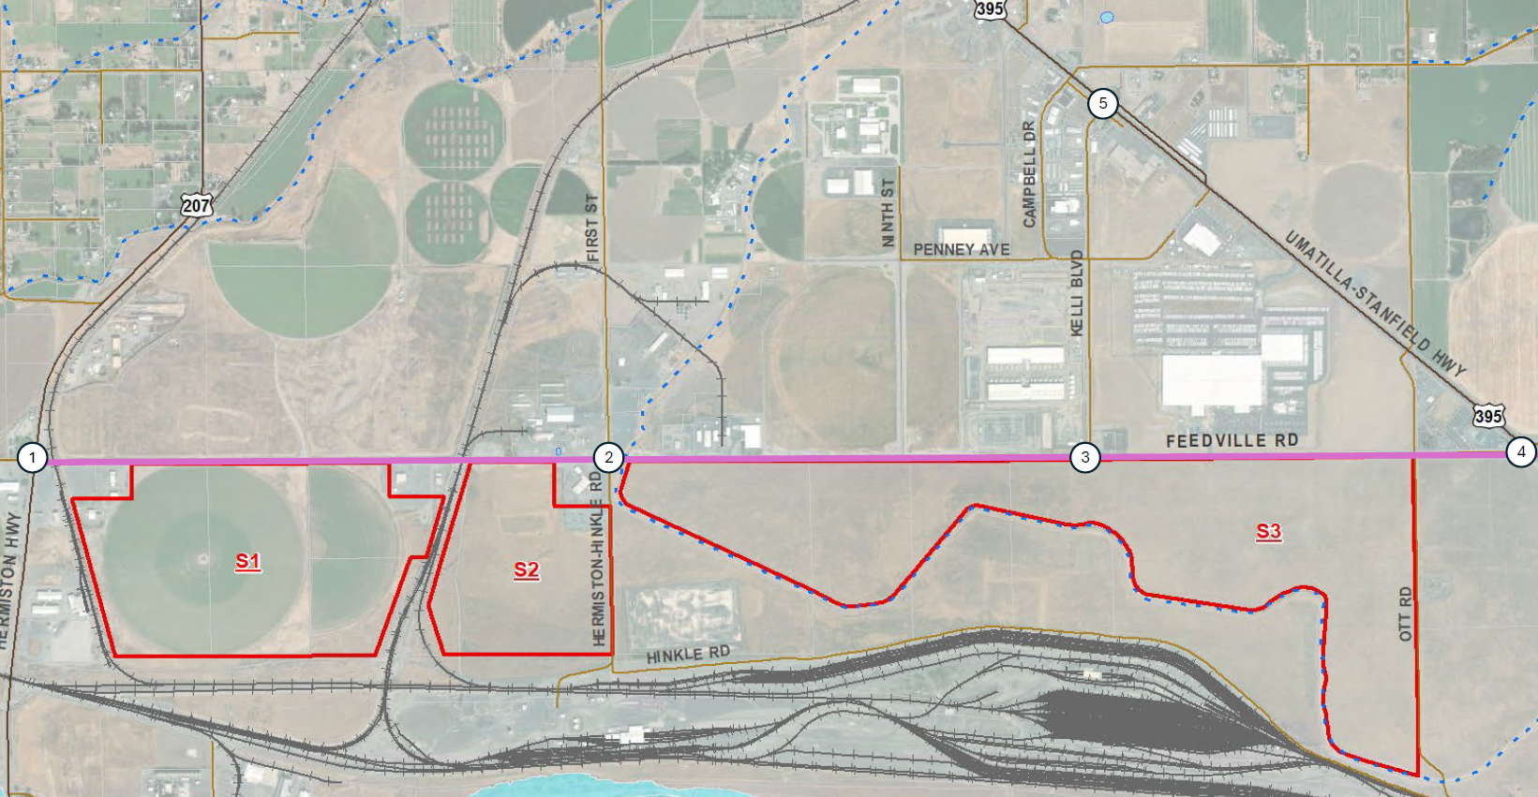
Public Facilities – Transportation
Required Intersection Improvements
Feedville Road Urban Corridor Improvements
(OR207 to US395)

Slide 14

Thank you!
Questions?
Notes:
Motions from Clint’s staff report.

