Slide 1
ROCK IT #2 QUARRY
APPLICATION TO SEEK GOAL 5 PROTECTIONS, APPLY THE AGGREGATE RESOURCE OVERLAY ZONE, AND ALLOW MINING, PROCESSING, BATCHING OF ASPHALT AND CONCRETE, AND STOCKPILING

Slide 2
Background and History
Site: (1) “Existing Approved Mining Operations” (TLs 700 & 800), (2) “Proposed New Mining Operations” (TLs 400, 500, 600, 1400, and 1500 in 4N 27 36 and TL 900 in 4N 27 25), (3) “Whole Site” (140-acres all TLs).
Existing Approved Mining Operations - 2012, 55 acres +/-(TLs 700 and 800), added to Umatilla County small significant sites list (#P-106-12) Conditional Use Permit #C-1204-12, approving mining and related activities.
Existing Approved Mining Operations - Zoning Permit for that CUP approved mining, scale house, batch plant (asphalt) and office building on TLs 700 and 800.
Existing Approved Mining Operations take access from Stafford Hansell Road, a paved county road.
The Existing Approved Mining Operations will not change under the proposal.

Slide 3
Background and History
Why this application? It was recently discovered that the office building had been inadvertently established on TL 900. Therefore, TL 900 had to be added to significant site list and the 2012 CUP mining operations approval.
Given quality and quantity of material available on the Whole Site, applicant decided to add the rest of the property (about 85 acres) to the county inventory of significant sites and make the Whole 140-acre site a “Large Significant Site.”.
Accordingly, this is a request to make the entire 140-acre subject property a “large significant site” composed of TLs 400, 500, 600, 1400, and 1500 (in 4N 27 36) and tax lot 900 (in 4N 27 25) (Proposed New Mining Operations) and TLs 700 and 800 (Existing Approved Mining Operations).

Slide 4
Background and History
The existing approved access on Stafford Hansell, serves the existing dwelling and the Existing Approved Mining Operations. The existing access to Stafford Hansell is on 900.
The Existing Approved Mining Operations that take their access off Stafford Hansel Rd., are not changing. The Existing Approved Mining Operations Tax Lots are already a significant site (small significant site) and are already approved for mining.
The changes being made by this proposal, are to allow the Proposed New Mining Operations and to make the Whole 140-acre Site a “Large Significant Site.”
Note: there is another property right of access on Stafford Hansell Road which the applicant may use in the future. Not at issue currently.

Slide 5
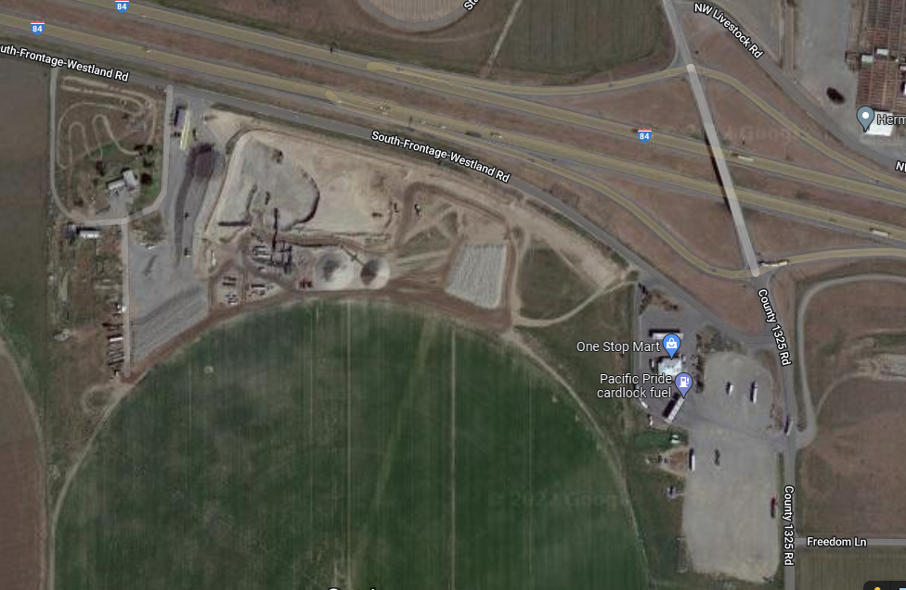

Slide 6
Background and History
Existing dwelling will be removed when mining needed where it is situated – likely up to 30 years.
Until then, the dwelling is rented, and the occupants require use of the existing Stafford Hansell access.
Existing Approved Mining Operations continue to require Stafford Hansell access.
Any new Colonel Jordan access would serve the Proposed New Mining Operations only.
Any new Colonel Jordan access will meet the requested access spacing from the interchange of 1320’ – but nothing justifies that alternative access yet.

Slide 7
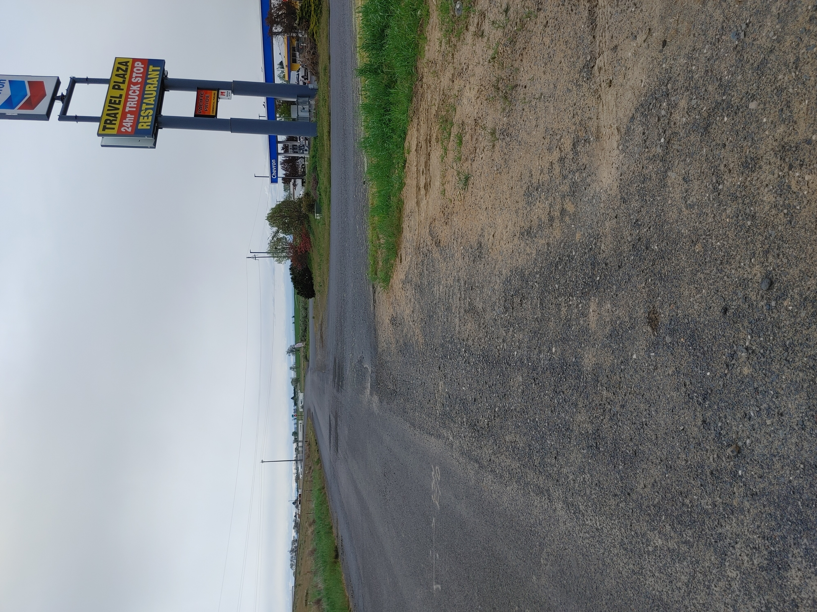
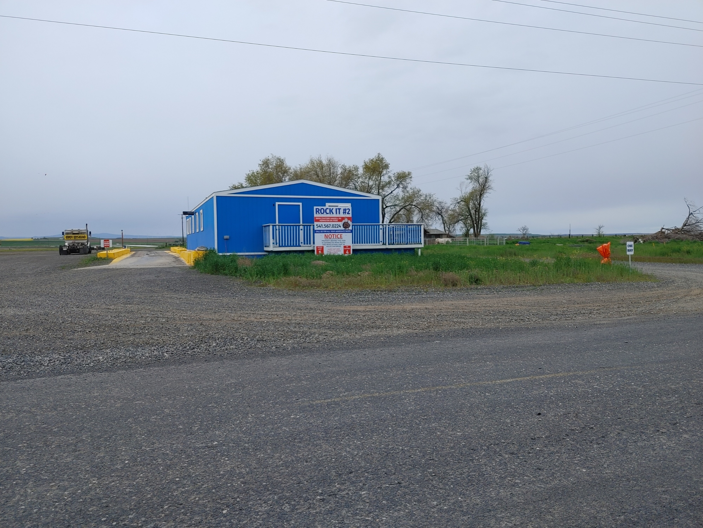
Accesses along Stafford Hansell Road
Rock It #2 Access
Managed one way in and out
Truck Stop Access
Two uncontrolled access points

Slide 8
Request:
List the Whole Site - approximately 140-acres - as a large significant site.
Apply the Aggregate Resource Overlay Zone to TLs 400, 500, 600, 700, 800, 1400, and 1500 of Assessor’s Map 4N 27 36 and tax lot 900 of Assessor’s Map 4N 27 to allow mining and related activities (Existing and Proposed, or Whole Mining Operation).
Allow Proposed New Mining Operations. NOTE: Mining operations are already allowed on the Existing Approved Mining Operations (TLs 700 and 800).
Allow stockpiling of the excavated material - Proposed New Mining Operations on the new TLs.
Allow processing of the excavated material - Proposed New Mining Operations on the new TLs.
Allow an additional batch plant for excavated material - Proposed New Mining Operations on the new TLs.
NOTE: Asphalt batching is already approved for Tax Lots 700 and 800 as part of the Existing Approved Mining Operations.
Not impose unconstitutional exactions of closing the existing access for unchanged operations and requiring the applicant to build out a whole new road (undeveloped Center Street) that does not now exist.

Slide 9
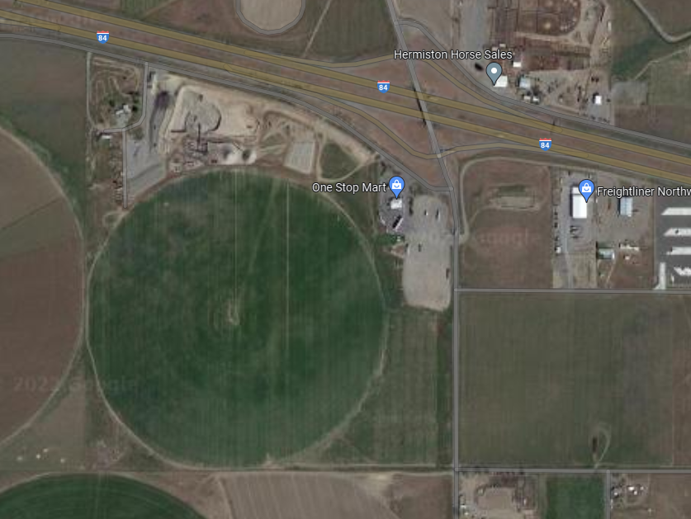

Slide 10
Site and surrounding area facts:
The Comprehensive Plan designation is North/South Agriculture.
Zoning - Exclusive Farm use.
Mining/concrete batching/ stockpiling etc., is allowed use on EFU land – if on the significant sites list and under a CUP.
Existing Approved Mining Operations and dwelling Access is from Stafford Hansell Road, a paved county road.
Adjoining land uses: truck stop to the east; transportation infrastructure; industrial uses to the north; and agricultural activities to the west, south, and southeast.
There is one home within 500-feet of the proposed mining area. It belongs to the applicant. It will be removed when the mine reaches it (approx. 3-5 years).
Zoning within the “Impact Area” includes EFU, Light Industrial, Rural Tourist Commercial, and Agri-Business.

Slide 11
Site Meets Significance Tests for “Large Significant Site.”
Over 4.8 million tons of sand and gravel are available on the subject property.
Testing of site materials for durability, soundness, and specific gravity exceeds the Oregon Standard Specifications for Construction: meeting specifications for a significant site.
No reasonable dispute: the site meets, and is estimated to exceed, both the quantity and quality criteria for a significant aggregate site per Oregon Administrative Rule 660-023-0180(3)(a).

Slide 12
Potential Conflicts:
Mining operation
Potential Conflict Activities in the Impact Area
Noise, dust, or other discharges from the mining operation could create conflicts.
The applicant and staff suggest condition, to mitigate.
Conditions: new residential and social gathering uses proposed in the future in the impact area be (1) informed of the mining operation and (2) required to sign a statement that they accept normal mining activity and their ability to pursue a claim for relief based on that activity is restricted.
Residential uses and social-gathering activities can create conflicts for the protected mining operation.

Slide 13
No New Traffic Impacts to Justify Proposed Condition to Close Existing Stafford Hansell Access Or to Improve Center Street
The Existing Approved Mining Operations front on, and take access from, Stafford Hansell.
Existing Approved Mining Operations DO NOT justify any conditions. There were no conditions about that access or even a discussion of the 2003 IAMP in the 2012 CUP for the Existing Approved Mining Operations.
No conditions about Stafford Hansell are appropriate here either: nothing about the Existing Approved Mining Operations that utilize Stafford Hansell are changing – the Proposed New Mining Operations adds no new impacts to Stafford Hansell.
Demanding the existing Stafford Hansell Rosd access be closed imposes unfair, unnecessary and inappropriate burdens on the applicant.
Traffic from the Proposed New Mining Operations are the same as for the Existing Approved Mining Operations.
No new employees, no new trips to get rock – processed or raw.

Slide 14
County Staff Requested Exactions
Close the existing access to Stafford Hansell used by the existing operation and existing dwelling.
Access only using Colonel Jordan Road via unimproved Center Street (which is a 30’ ROW not a 40’ ROW).
Applicant strongly objects to these requested exactions that will cost hundreds of thousands of dollars, result in unsafe and vastly inefficient vehicular travel, and are unwarranted.
The requested exactions do not meet applicable legal tests.

Slide 15
Exactions Primer
To be lawful, government demanded exactions must meet two important constitutional tests:
They must have an “essential nexus” to an applicable approval standard.
AND
They must be roughly proportional to the impacts of the proposed development.
The county bears the burden of proof to prove both.
The requested exactions here meet neither. The county made no effort to carry its burden to prove entitlement to the requested exactions. That is because they do not and cannot meet that burden.

Slide 16
County Planning Department Access Exactions Lack Essential Nexus
County Essentially Admits That There is no “Essential Nexus” to any Relevant Approval Standard
County staff requested exactions to close the existing Stafford Hansell access, and to improve Center St. to get to Colonel Jordan, rests entirely on the IAMP and ODOT. Yet the staff report acknowledges:
  “Oregon Department of Transportation (ODOT), provided comment stating that the current access point to Colonel Jordan Road is approximately 240 feet from the I-84 eastbound exit ramp. This could cause congestion at the intersection, should new commercial vehicle trips be generated using the frontage road in close proximity to the interchange.”
If there are no new commercial trips from the proposal, then the IAMP and ODOT do not require these exactions. No essential nexus to any approval standard for the exactions.
The proposal adds NO NEW commercial trips. At the worst, perhaps 30 new trips are added to retrieve product from the concrete batch plant, but those will be at a different Stafford Hansell access that already exists as a property right.
That is NOT enough to demand to close an access, requiring an applicant to build hundreds of thousands of dollars worth of new access over an otherwise totally unimproved Center Street

Slide 17
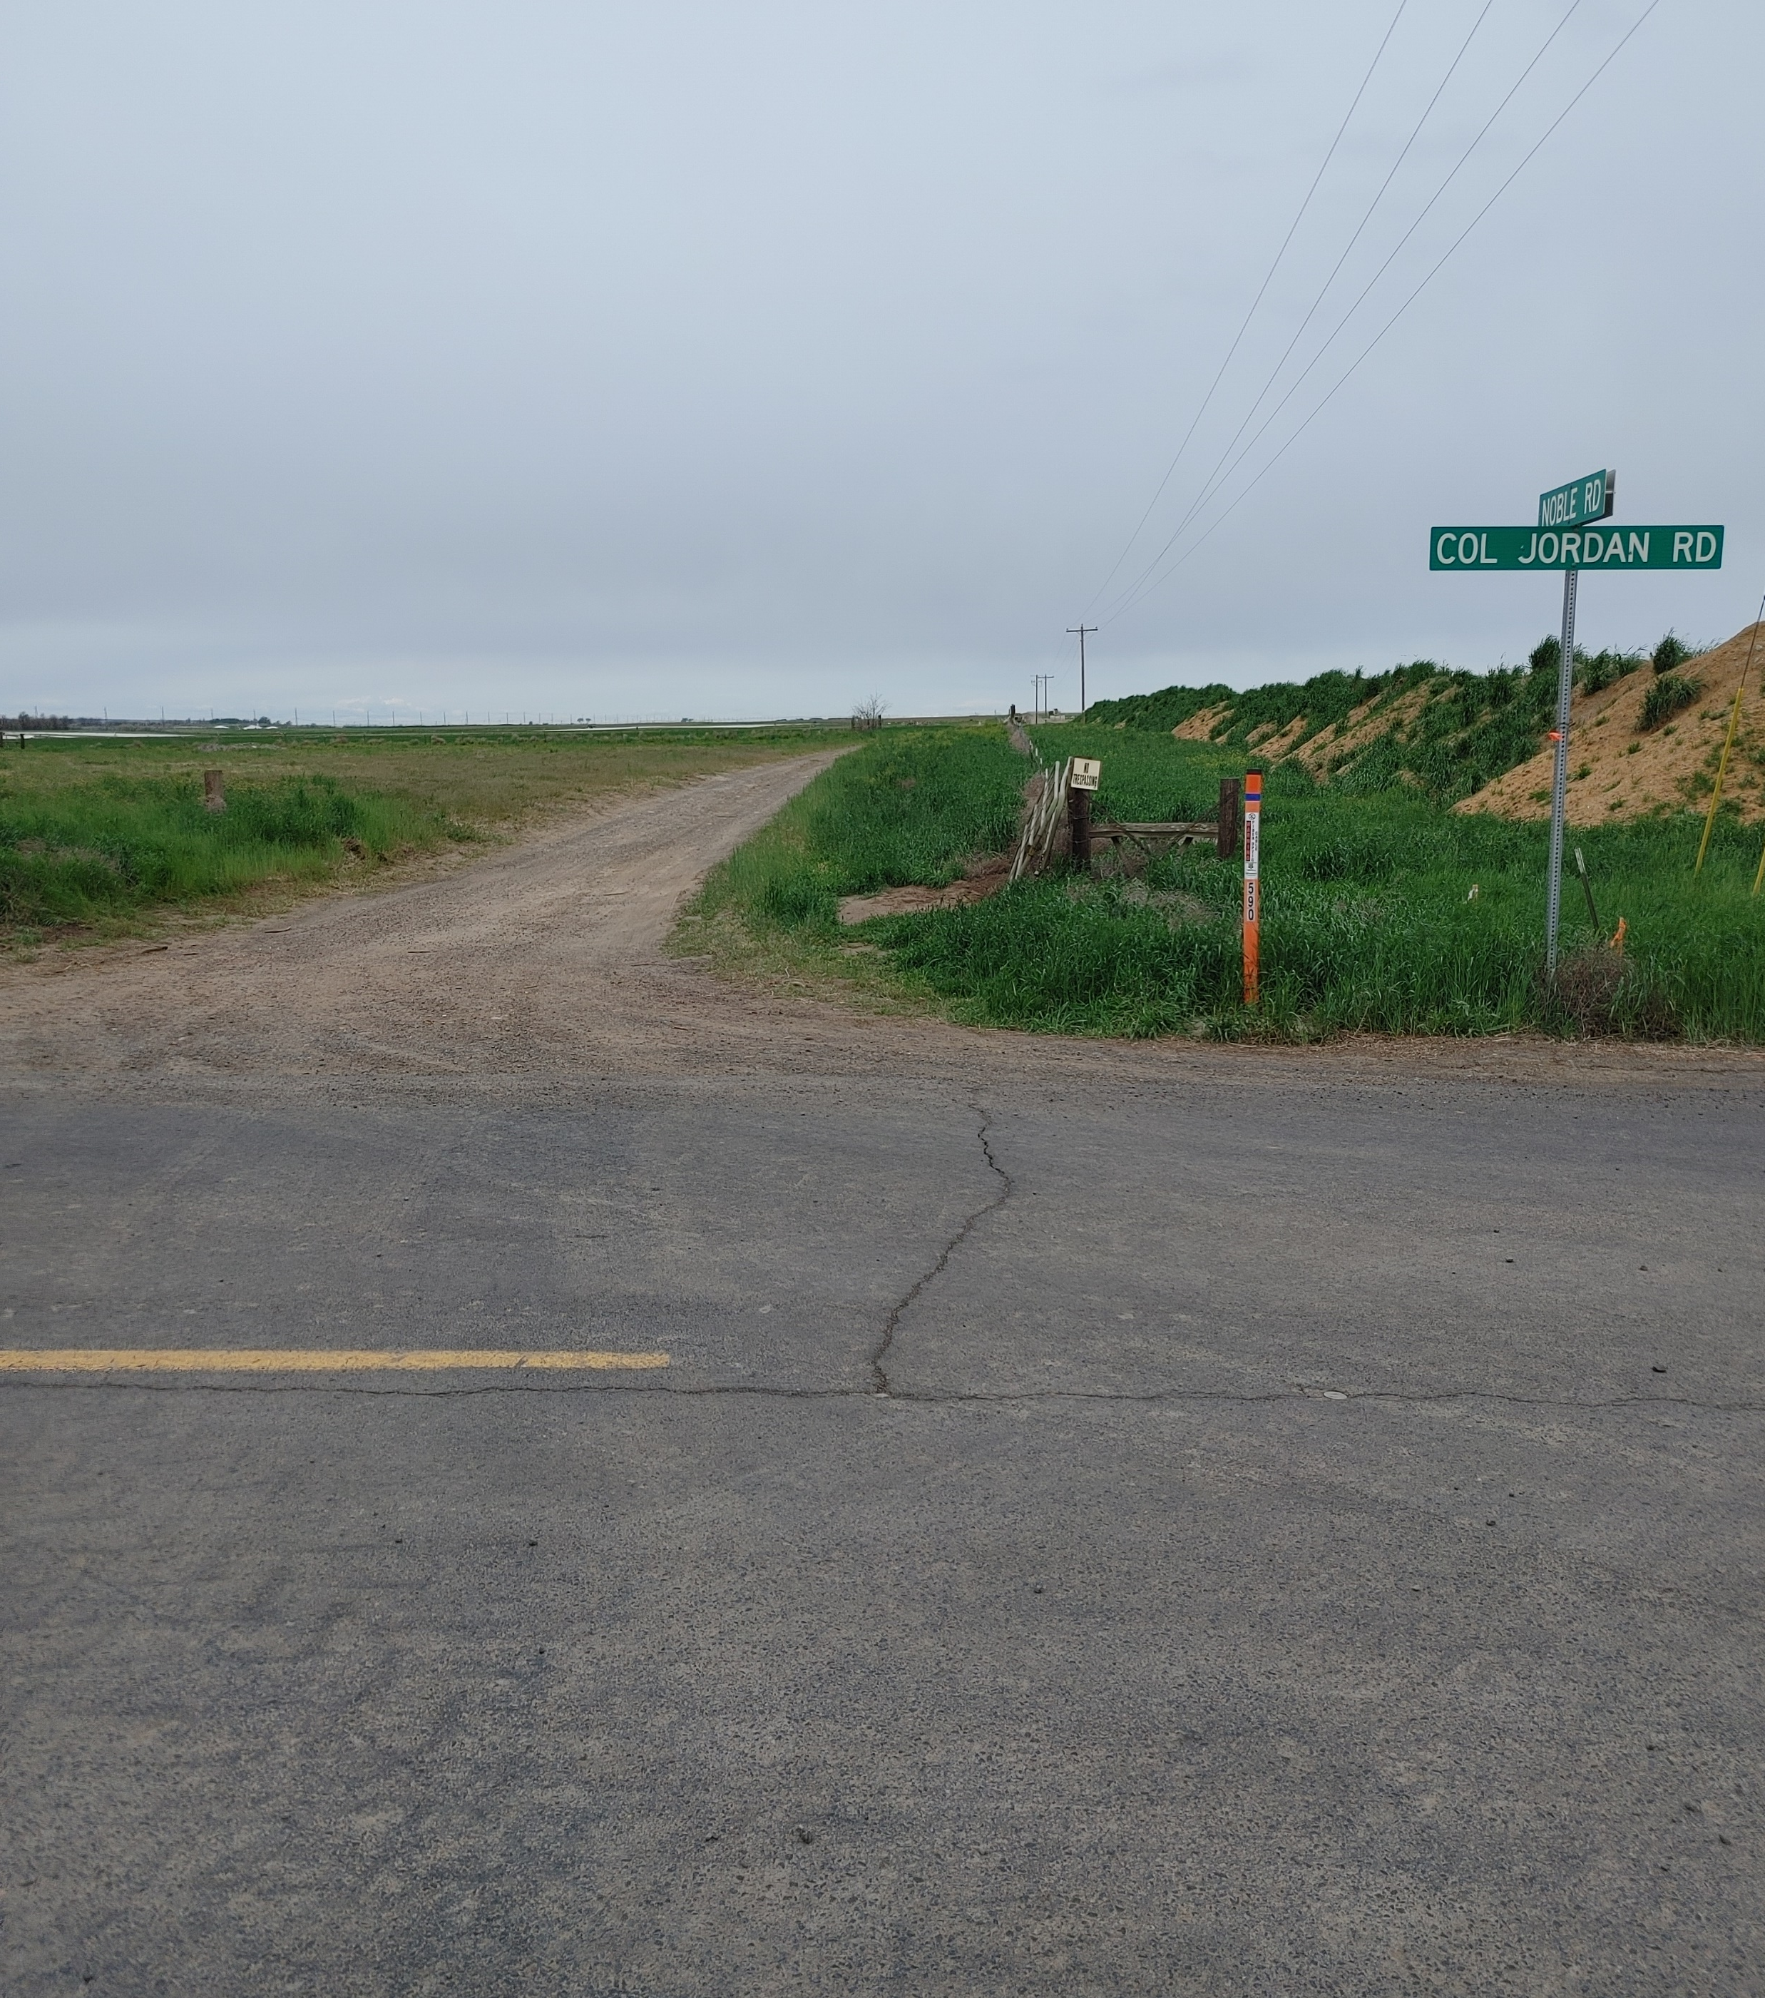
CENTER STREET
Center Street is an unimproved 30-foot right of way dedicated in 1910. It is seen here from the intersection of Colonel Jordan Road and Noble Road. It appears, based on mapping, that it would align with Noble Road, requiring the removal of fencing and utility infrastructure owned by most likely Umatilla Electric. The farm road shown in this picture does not align and is most likely constructed on the property to the south of the subject property.

Slide 18
Lack of Essential Nexus:
The Westland Road/I-82 IAMP does not require access points be at least 1320-feet from the interchange, regardless.
The first listed IAMP “option” is for new commercial trips to have their access points just over 600-feet from the Interchange
The second IAMP “option” is for new commercial trips to have their access points just over 900-feet from the Interchange,
Neither impose a 1320-foot access spacing standard from the interchange to support staff’s requested exaction of closing any existing access to Stafford Hansell whether there are not appreciable new commercial trips; and support requirement to build unknown feet of wholly new roadway over Center Street to Colonel Jordan.
If the County imposed any exaction to demand closure to the applicant’s existing Stafford Hansell accesses and put a new one on Colonel Jordan any of these distances, there would be significant conflicts with the neighboring truck stop, which is one of the largest traffic generators at the Interchange, yet there is no meaningful access control for the truck stop, creating safety hazards.

Slide 19
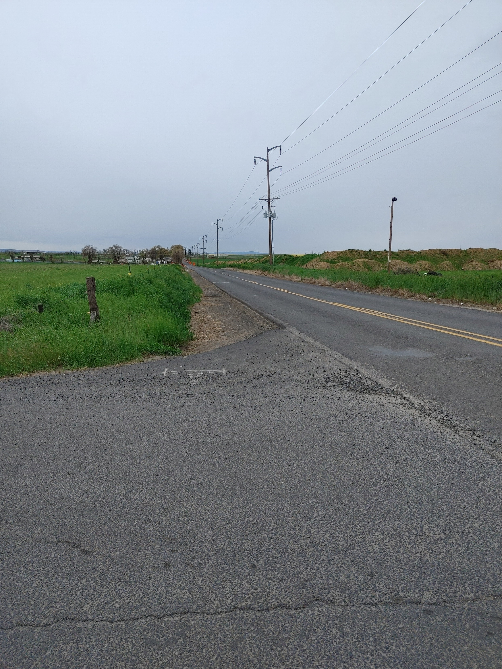
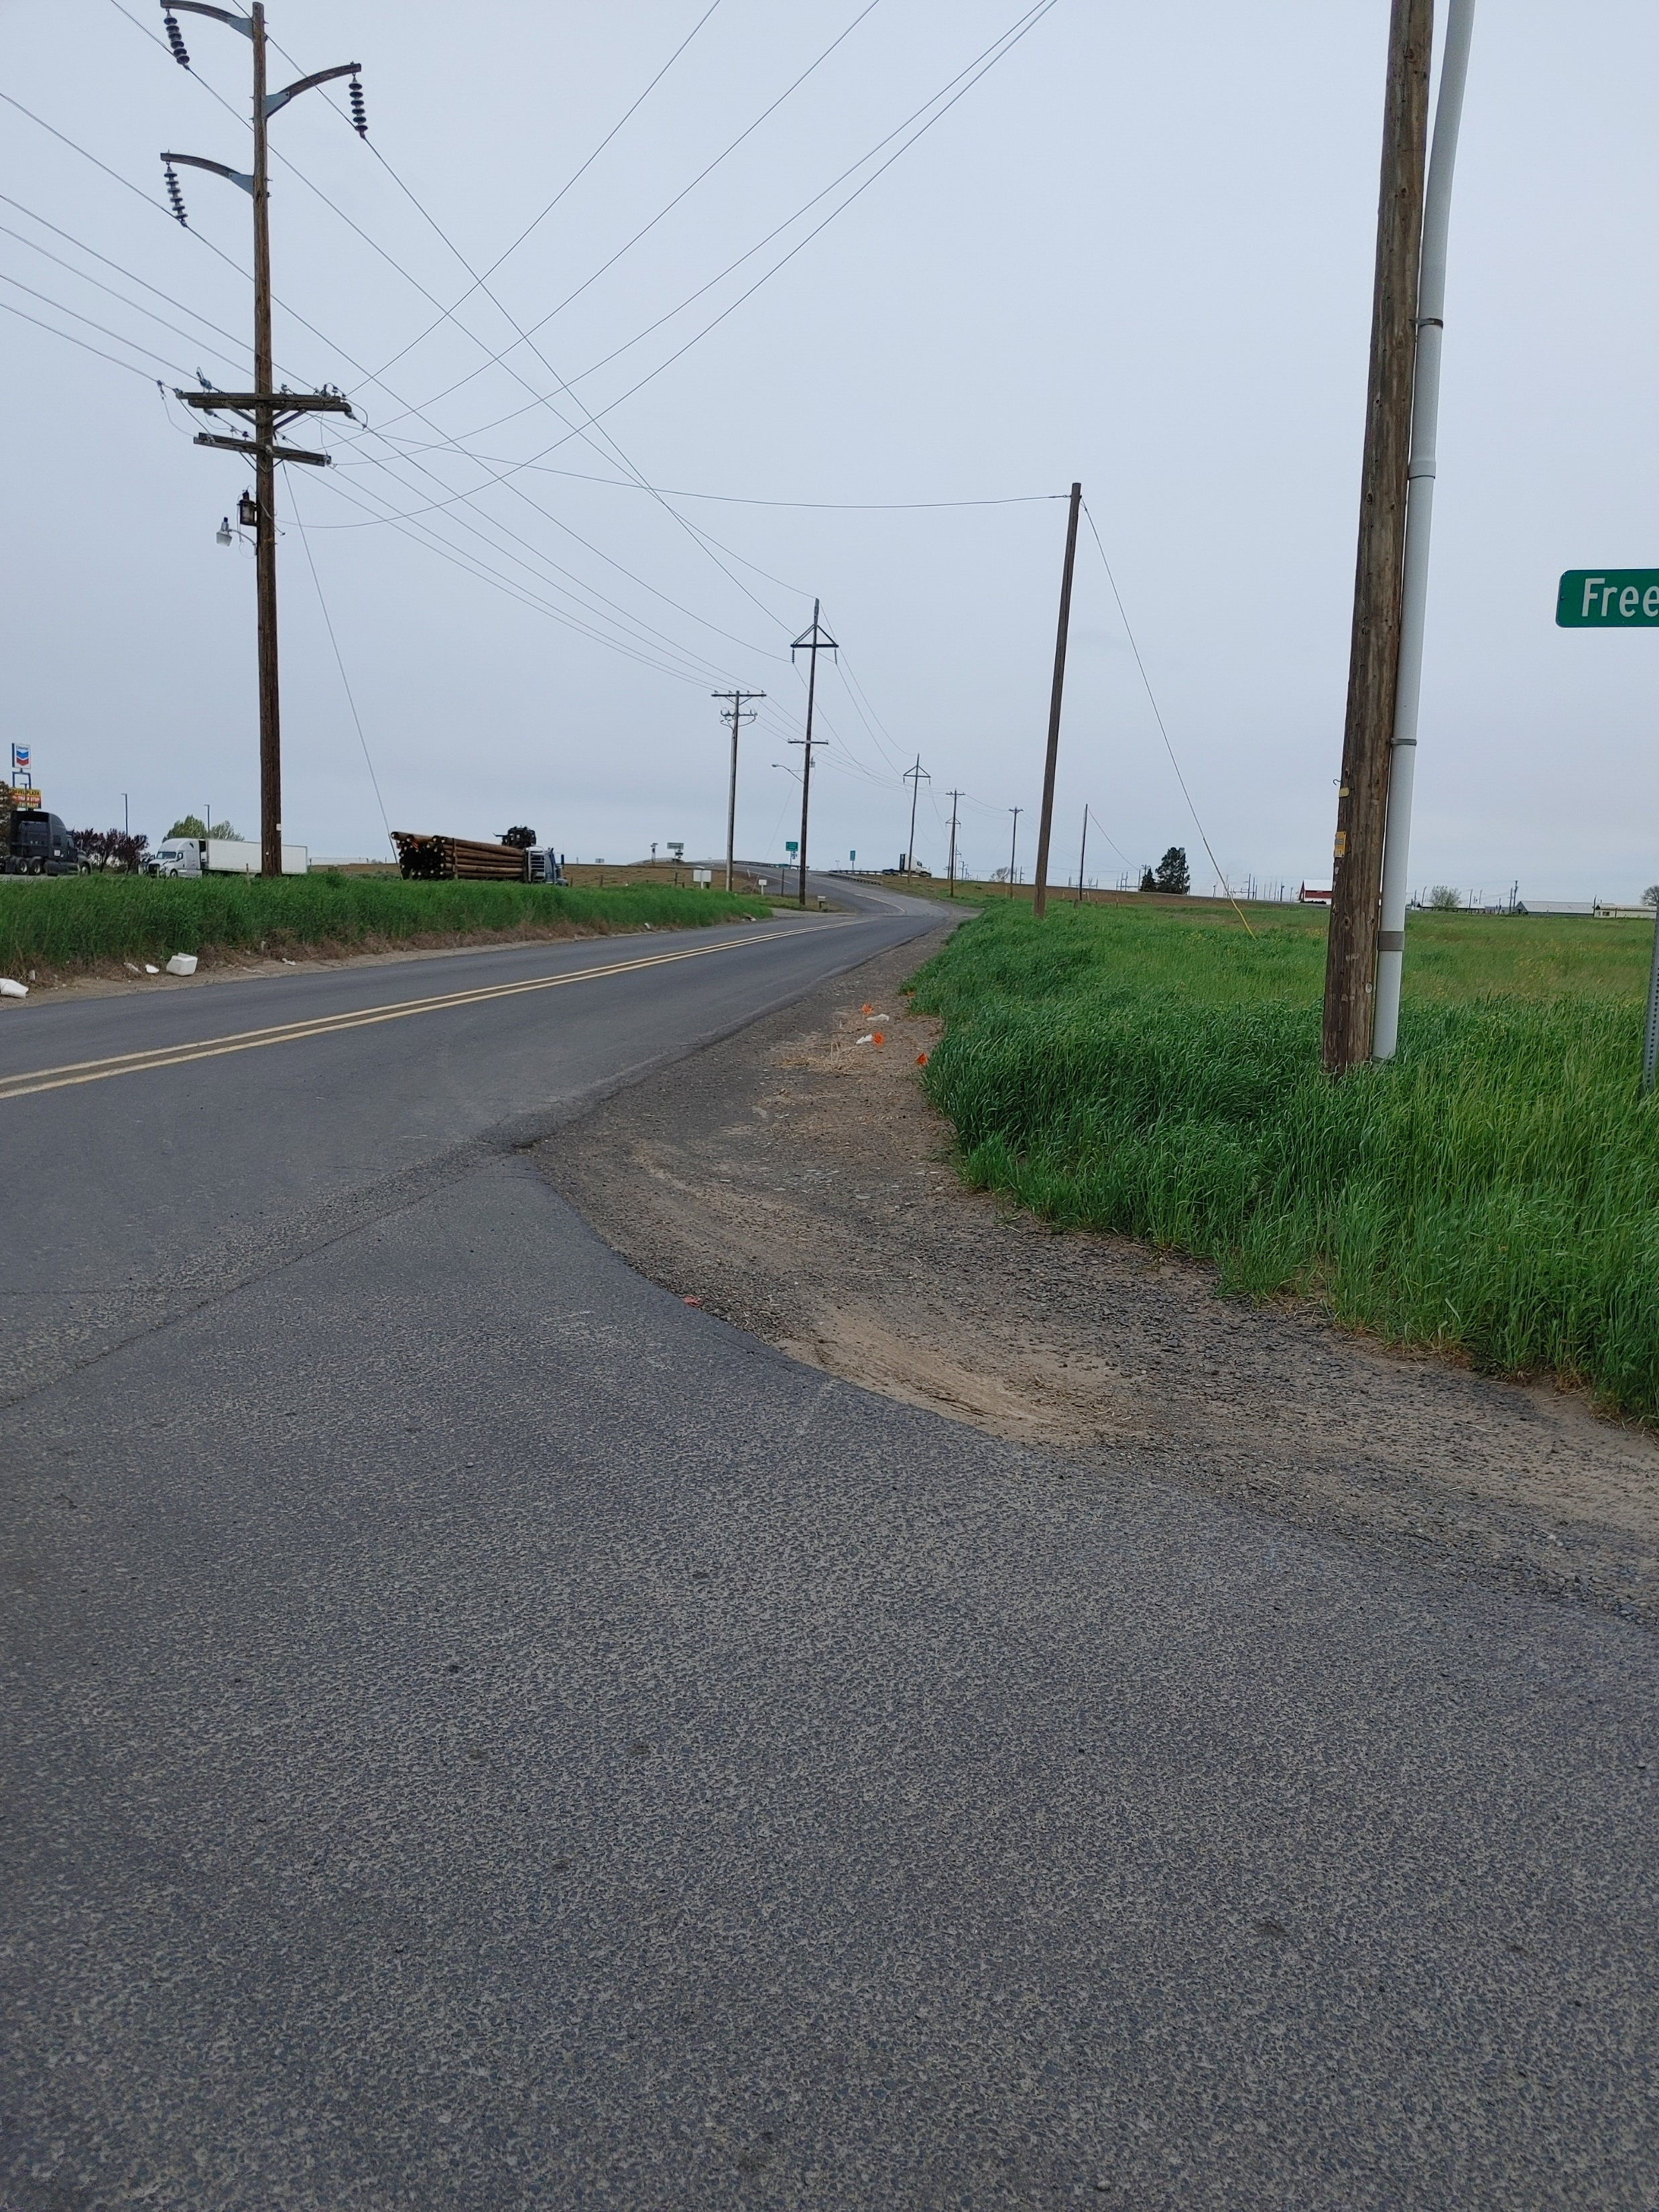
The view of Colonel Jordan Road from Freedom Lane – to the south and to the north
Freedom Lane is approximately 900 feet from the Interchange

Slide 20
No Rough Proportionality
Even if they could get past the requirement for an “essential nexus”, County staff make no effort to carry their burden to prove their requested exactions are roughly proportional to the impacts of the proposal.
They cannot carry that burden as a matter of law.
Traffic trips will be the same regardless of whether there are 55 acres to mine or 140 acres to mine. The mining operation mines a particular area of the property and processes it and moves it out. When one part is exhausted, mining moves to another part of the property.
It is not the case that the applicant will go from mining 55 acres all at once to mining 140 acres all at once. Rather traffic in and out will remain substantially the same as now if the proposal is approved.
Adding the concrete batch plant does not significantly increase the number of trips – it just processes material differently.
Trips associated with concrete batch plant will use other existing right of access on Stafford Hansell Road.
At most there may be times when both the concrete and asphalt batch plant are working. But even so, in a day, the concrete batch plant might add on average 35 new daily trips, which is hardly “roughly proportional” to a demand to close an existing access that the asphalt batch plant will not use and requiring that the applicant build a 40’ wide access for an unknown distance over Center Street’s 30’ ROW to reach a wholly new access on Colonel Jordan to the tune of several hundred thousands of dollars.

Slide 21
Rough Proportionality Cannot be Met
ODOT data for both west and eastbound on and off ramp annual average daily trips - the interchange in 2019 was not significantly busier than when the IAMP was approved in 2003 and is significantly less busy than in the years 2011 and 2012. The table shown here is a representative sample of years between 2002 and 2019, the last year data is available.
The additional 35 trips that might flow from the proposed concrete batch plant have nothing to do with the Stafford Hansell access the county seeks to close and are a very small fraction of the total. They do not justify exactions or closing of property rights of access or demands to build new roads.
Trips from the approved asphalt batch plant will be to Colonel Jordan Road. Applicant will get access permit for this at 1320-feet from Interchange.
Westland Road Interchange - Exit 180
 | WB On Ramp | WB Off Ramp | EB On Ramp | EB Off Ramp
2002 | 520 | 460 | 470 | 460
2003 | 520 | 460 | 470 | 450
2006 | 860 | 900 | 1030 | 920
2007 | 870 | 920 | 930 | 1040
2011 | 1090 | 1120 | 1420 | 1450
2012 | 1080 | 1110 | 1400 | 1480
2016 | 1150 | 970 | 1600 | 950
2017 | 690 | 640 | 670 | 660
2018 | 720 | 680 | 700 | 690
2019 | 720 | 680 | 700 | 690

Slide 22
Lack of Rough Proportionality
Stafford Hansell Road is the current point of access for the Existing Approved Mining Operations, is a paved County road providing access to a dwelling and the Existing Approved Mining Operations that are not changing under the proposal.
Applicant also has property right of access at another location on Stafford Hansell Road that may not be taking without meeting rough proportionality.
The applicant has indicated that an access will be requested to Colonel Jordan Road, a paved County road in good condition, in the future when activities within the mining area require it. They understand a county access permit will be required and don’t mind making sure it is 1320’ from the interchange, even though that cannot be required. But it is not needed now. And there is no showing of either essential nexus or rough proportionality for it now.
Center Street is an undeveloped public right of way almost a mile from the current access point along County roads and over a ½ mile from current mining operations across the subject property.

Slide 23
Neither Essential Nexus Nor Rough Proportionality are Met
Three proposed Conditions of Approval fail to meet the required constitutional tests and should be rejected:
Obtain an Umatilla County Public Works Road Approach Permit for Colonel Jordan Road to Center Street, to be named Noble Road.
Improve the existing [40]-foot public right of way, Center Street, to be named Noble Road to the gravel County Road standard. [The ROW is actually only 30’.]
Discontinue the site access from Stafford Hansell Road.

Slide 24
Applicant’s Request of the Planning Commission:
Amend the Staff Report to remove and amend the findings related to the IAMP and the relocation of the access from Stafford Hansell Road to Colonel Jordan Road via Center Street (Noble Road). Pages 10-11, 15, 29, and 33.
Remove Conditions of Approval 2, 3, and 4. Pages 33-34.
Include a Condition of Approval to require that if the applicant requests a future access to Colonel Jordan Road, that the applicant must obtain a county access permit.
The applicant does not object that such new access to Colonel Jordan be required to meet the 1320-foot access standard, even though it does not apply. You can impose a condition that any new access on Colonel Jordan is 1320’ from the interchange.

Slide 25
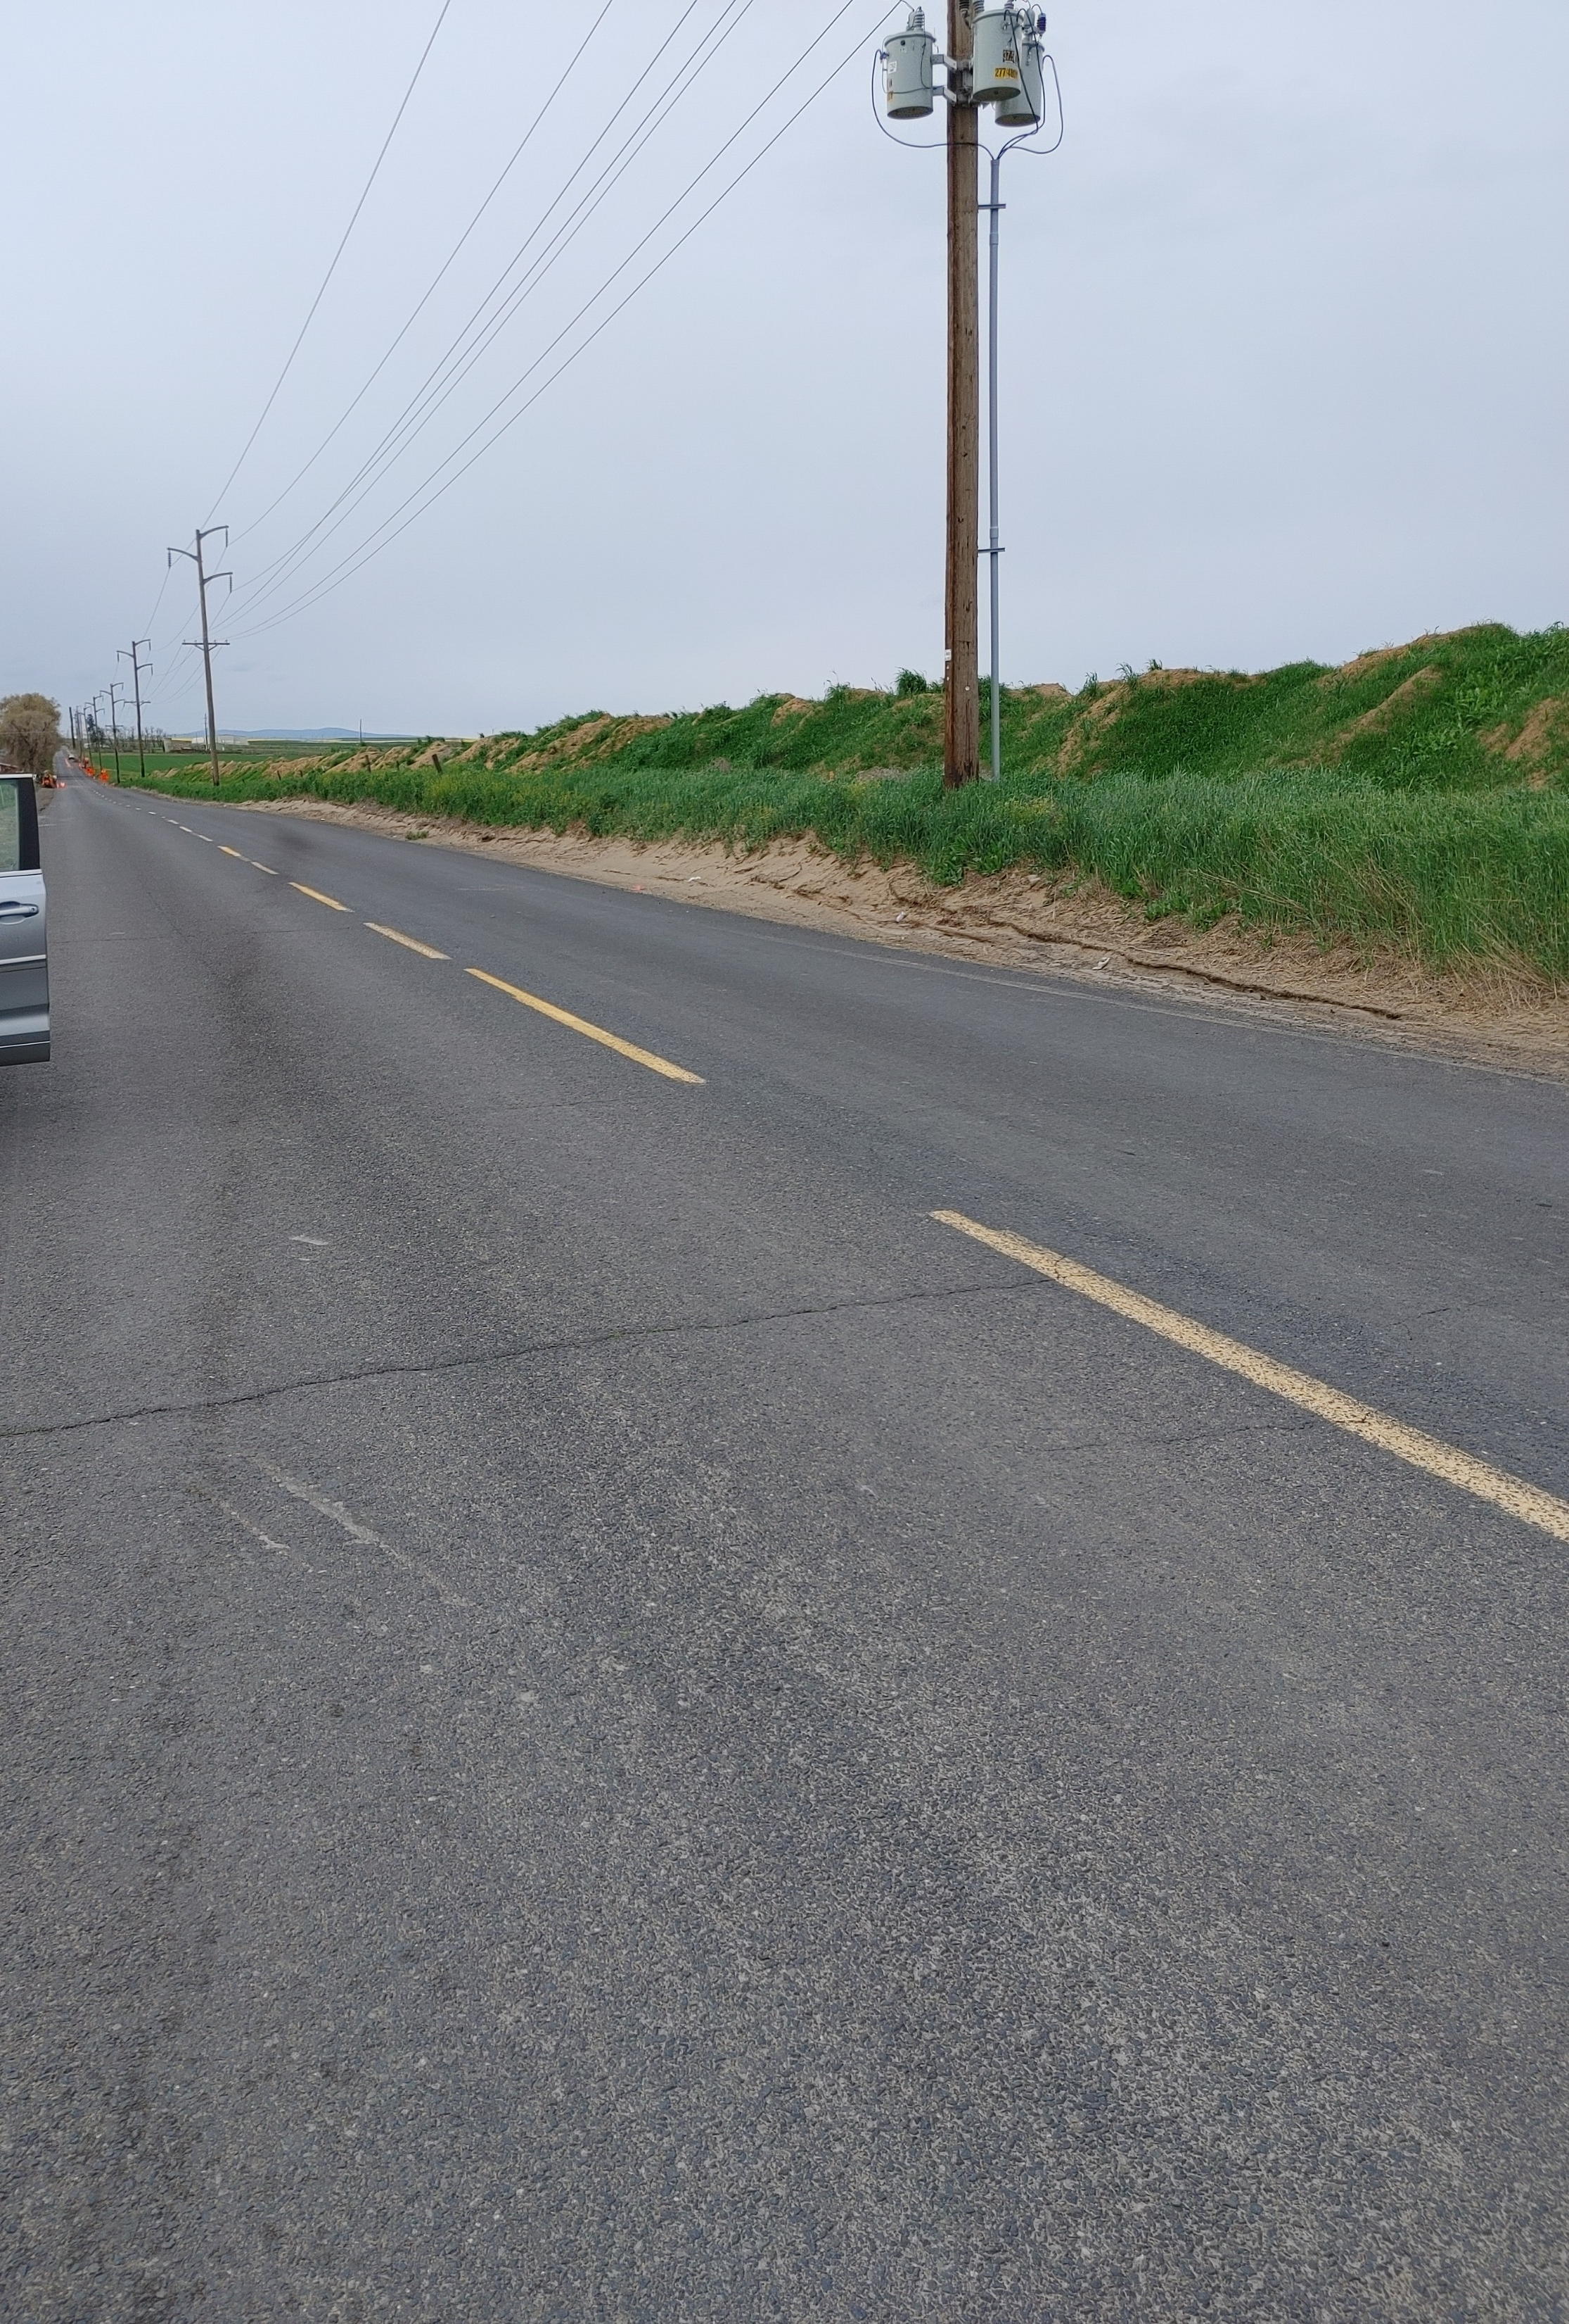
Colonel
Jordan
Road
This view is looking south along Colonel Jordan Road at about the 1320-feet point.

Slide 26
Questions?
Thank you for your time and consideration. Do you have any questions?

